Slide 1
Asteroid composition
Surface composition detection using digital images
This presentation, research, and source code is available at:
https://github.com/swacad/Asteroid_Mining

Slide 2
Spectroscopy
The study of observed electromagnetic emissions to deduce chemical composition of the observed material.
Based on the fact that different chemical structures absorb and reflect different wavelengths of light.
By measuring the amount of reflected sunlight from an asteroid at the different wavelengths in the electromagnetic spectrum we can gain information about the chemical composition of the asteroid.
http://www.lpi.usra.edu/books/AsteroidsIII/pdf/3032.pdf
https://en.wikipedia.org/wiki/Emission_spectrum

Slide 3

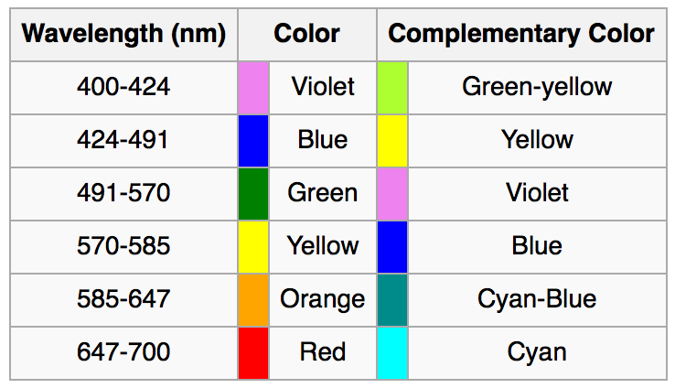
Visible Wavelengths
Human visible light wavelengths range from 380 nm to 760 nm
https://en.wikipedia.org/wiki/Electromagnetic_spectrum#Visible_radiation_.28light.29
http://www.midnightkite.com/color.html

Slide 4
Asteroid Composition
Meteorites are asteroids that have impacted the earth. They give a clue to possible asteroid composition
Iron meteorites
Iron: 91 percent
Nickel: 8.5 percent
Cobalt: 0.6 percent
Stony meteorites
Oxygen: 36 percent
Iron: 26 percent
Silicon: 18 percent
Magnesium: 14 percent
Aluminum: 1.5 percent
Nickel: 1.4 percent
Calcium: 1.3 percent
http://www.space.com/51-asteroids-formation-discovery-and-exploration.html
https://en.wikipedia.org/wiki/Asteroid#Composition

Slide 5
Problem: Light signals are noisy
Measurements taken by cameras are inherently noisy.
For most images we don’t know how well the camera was calibrated
We don’t know the albedo (ratio of surface reflectance) for the asteroid.
High albedo surfaces will have lots of specular reflection meaning that they will tend to look dark if the reflected light is not at the same angle as the camera lens
We don’t know the albedo of the surface because we don’t know what the surface composition is but we’re trying to use light emissions to estimate surface composition.
Atmosphere of earth also distorts signals by absorbing some of the wavelengths.

Slide 6
Problem: Surface light can be affected by other physical factors
Asteroid surfaces have craters which appear darker
Cratered surfaces also have slightly different surface composition because the impact that produced the crater adds heat and pressure to the surface which changes the chemical composition.
Objects impacting the asteroid surface also deposits foreign materials on the surface.
Space Weathering
Reduces the albedo of the surface by depositing metal nanoparticles on the surface of the asteroid. Produces darker surface over time.
This means fresh craters will have higher albedo and have electromagnetic emissions more likely to reflect the actual composition of the asteroid.
http://www.lpi.usra.edu/books/AsteroidsIII/pdf/3032.pdf
https://news.brown.edu/articles/2012/10/vesta
https://en.wikipedia.org/wiki/Space_weathering

Slide 7

Problem: Determining Probabilities
Baye’s Rule: $P\left(a | b\right)= \frac{P\left(b | a\right)P(a)}{P(b)}$
$P(a)$ is the prior but we don’t really know what the prior is. This can discovered reasonably accurately with large data sets but the data is very limited.

Slide 8

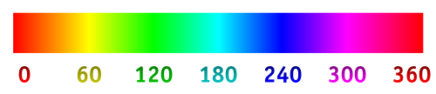
Problem: Recover wavelengths from RGB Space
This is technically impossible since an infinitely many combinations of wavelengths can produce the same perceived color to the human vision system.
RGB is an approximation of real color by adding three primary colors from the red, green, and blue wavelengths.
We can approximate wavelengths from RGB by converting to hue, saturation, and value (HSV) format.
The hue value which ranges from 0 to 360 degrees can be used to estimate wavelength.

Slide 9

Asteroid RGB Image Algorithm
Initialize image array (slice out image patch if necessary)
Compute wavelengths
Compute hues in degrees (slice out hue channel after converting RGB image to HSV)
Compute wavelengths from hues where wavelength is approximated by: $l=620−\frac{170}{270}∗270∗h$, where $l$ is wavelength in nanometers.
Convert wavelengths to other distance type if necessary (e.g. from nm to microns)
Filter image if necessary (e.g. Gaussian blur)

Slide 10

OpenCV hue to Wavelength Conversion Approximation
OpenCV stores hue values for 8-bit images in the range of 0 to 179 as opposed to 0 to 359 to fit the entire range into the 8-bit field.
http://docs.opencv.org/3.1.0/de/d25/imgproc_color_conversions.html
So we can normalize the range from 0 to 359 by multiplying values by two and perform the approximation conversion given by the following equation:
$l=620−\frac{170}{270}∗270∗h$
Where: $l$ is wavelength in nm and $h$ is the hue value from 0 to 359.
http://stackoverflow.com/questions/11850105/hue-to-wavelength-mapping

Slide 11
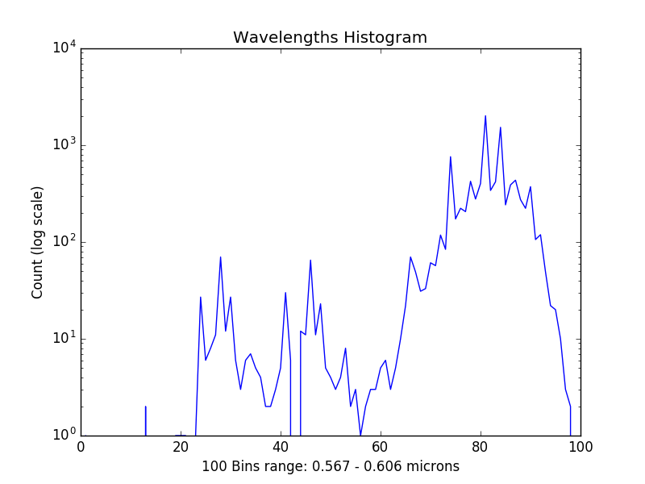
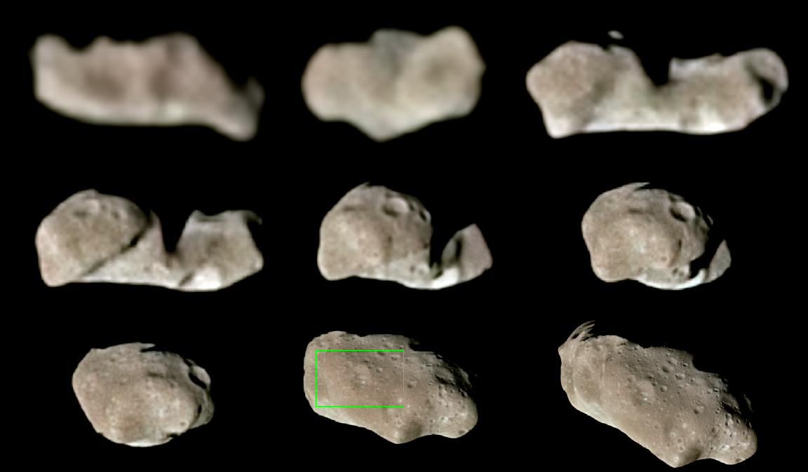

Sample Data:
Patch of sample in green rectangle
$μ=0.599023$
$σ=0.00205689$

Slide 12
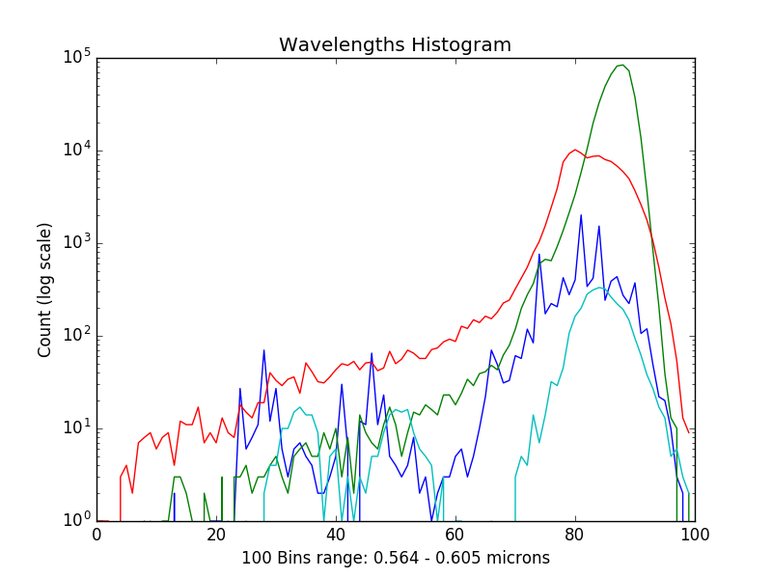
All Wavelength Histograms
Blue: Ida
Green: Olivite
Red: Chondrite
Light blue: Eros

Slide 13
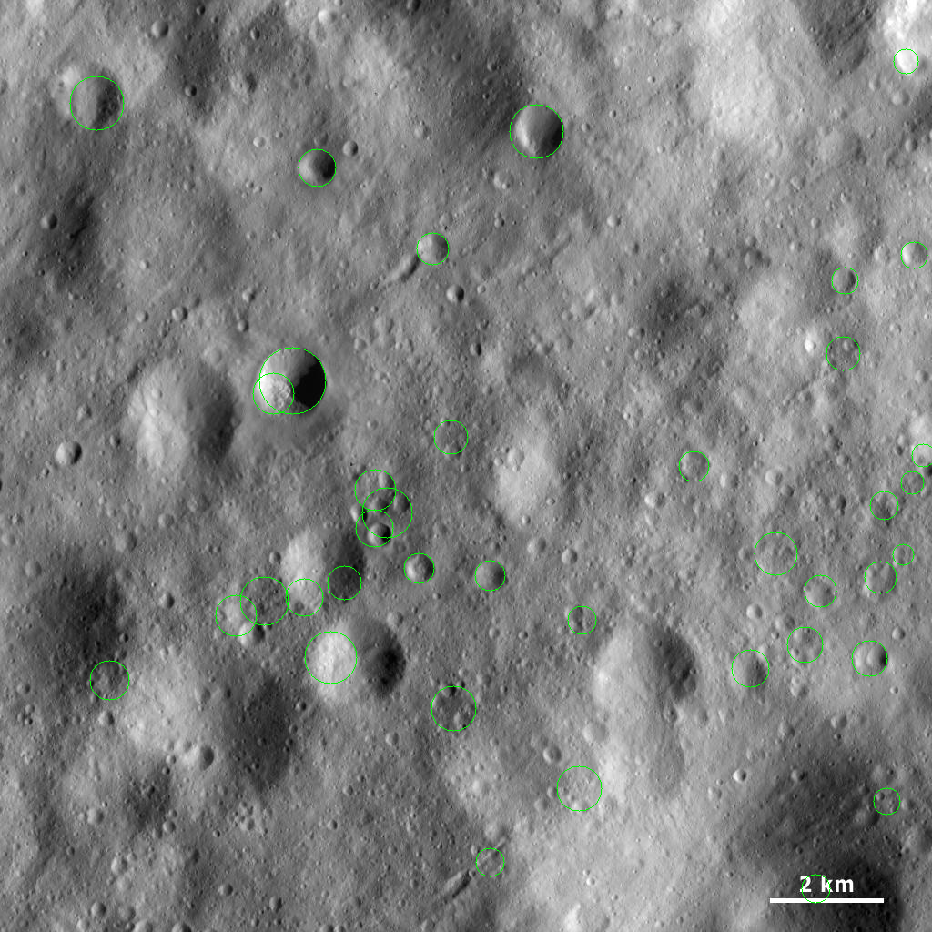
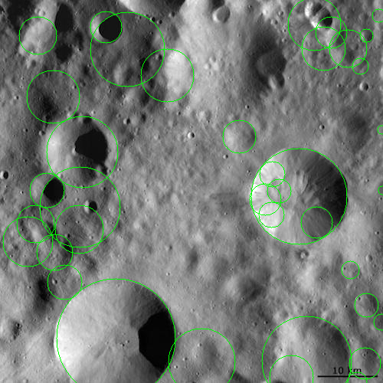
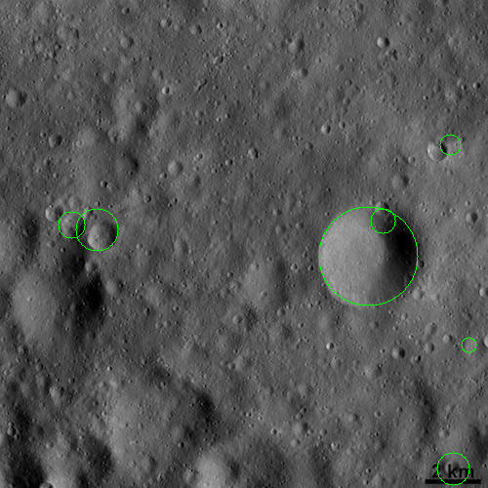
Bonus Feature: Crater Detection
Requires tuning to get good results. Green circles show detected craters.

